Slide 1
Artificial Intelligence in Fintech Quiz (3)
Shaif Chowdhury

Slide 2
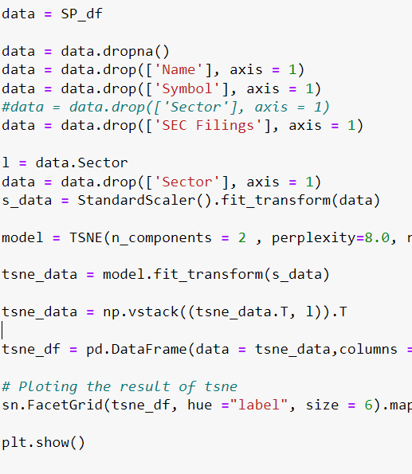
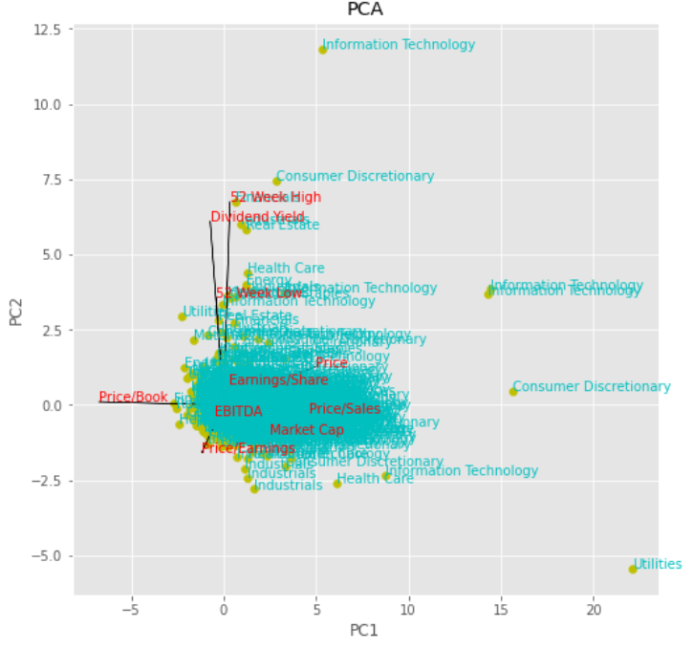
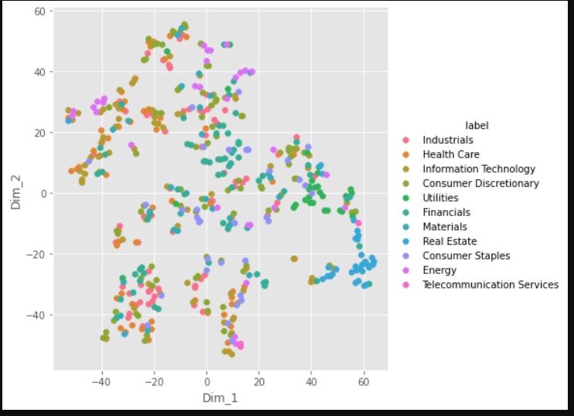
SP500 Sectors : PCA TSNE
Visualize the section information of the SP500 data :

Slide 3
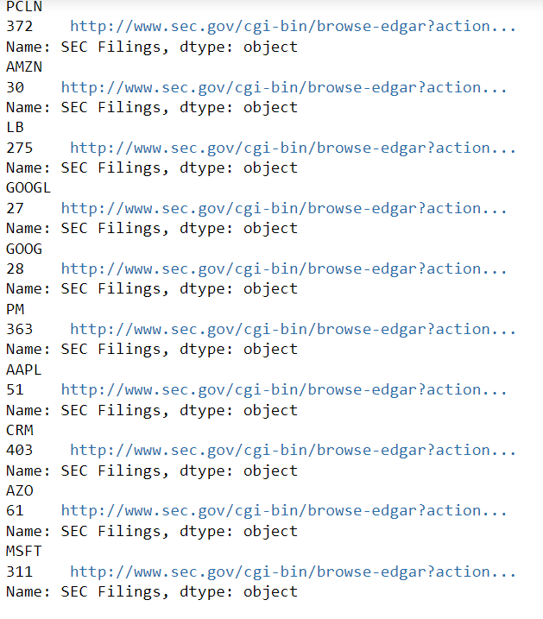
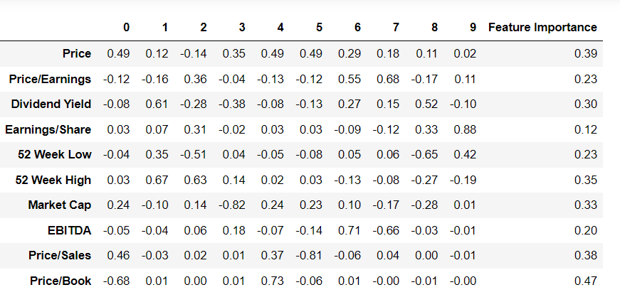
SP500 PCA : Feature Importance
Check sections 2 and 3 information of the SEC 8K of the top-10 ranked stocks what can you find?
SEC 8K has the earnings release for the stocks listed here.

Slide 4
PCA BiPlot TriPlot

Slide 5
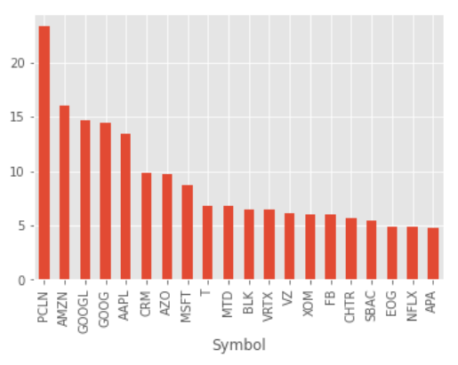
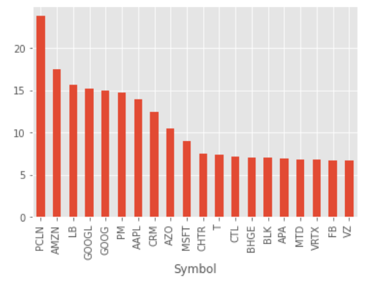
SP500 Ranking : NSVA , SPCA
NSVA PCA

Slide 6
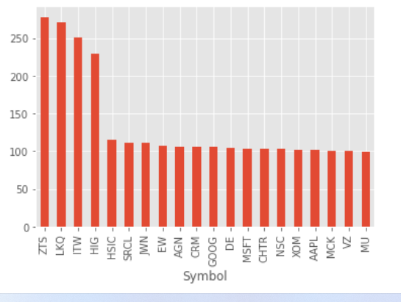
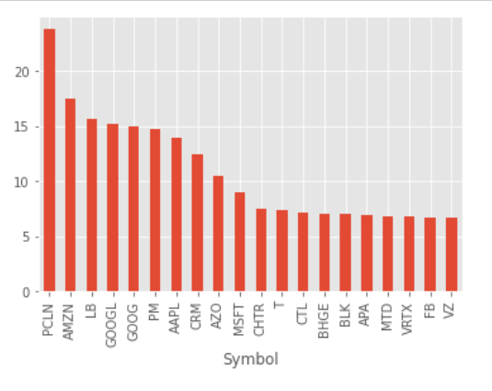
A. SP500 TSNE Rank PCA Rank

Slide 7
Code :
def doTSNE(data,k):
l = data.index
s_data = StandardScaler().fit_transform(data)
model = TSNE(n_components = 3 , perplexity=k, random_state = 0)
tsne_data = model.fit_transform(s_data)
#tsne_data = np.vstack((tsne_data.T, l)).T
return tsne_data
n = doTSNE(VC_df,20)
##TSNE
def do(data):
data = data.dropna()
d = data
data = data.drop(['Name'], axis = 1)
data = data.drop(['Symbol'], axis = 1)
data = data.drop(['Sector'], axis = 1)
data = data.drop(['SEC Filings'], axis = 1)
AAPL = data
AAPL = StandardScaler().fit_transform(AAPL)
n,pca = doPCA(data)
PC = pca.components_
PC_df = pd.DataFrame(data=PC)
X = n
np.shape(X)
newData_df = pd.DataFrame(data = X, columns = ['PC' + str(i) for i in range(X.shape[1])], index = d.Symbol)
newData_df.head(1)
df = pd.DataFrame(data = X)
newData_df['Ranking'] = newData_df.apply( lambda x : np.sqrt(x.dot(x)), axis =1)
ranking_20 = newData_df.Ranking.sort_values(ascending = False)[0:20]
#print(ranking_20)
ranking_20.plot.bar()
plt.show()
do(SP_df)

Slide 8
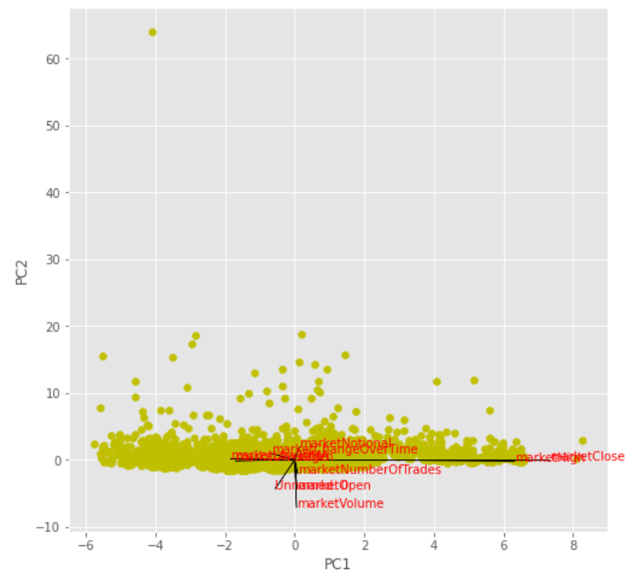
B. HFT feature interpolations : 2. PCA
Variables :
My Finance knowledge is limited. So, I’m not sure what kind of variables would create better result. But these variables decrease the variance concentration, and It can be observed in the plot.
HFT PCA
Feature
return | 10MA | 20MA | 40MA | kurt | skew | Up | Down | UpDown

Slide 9
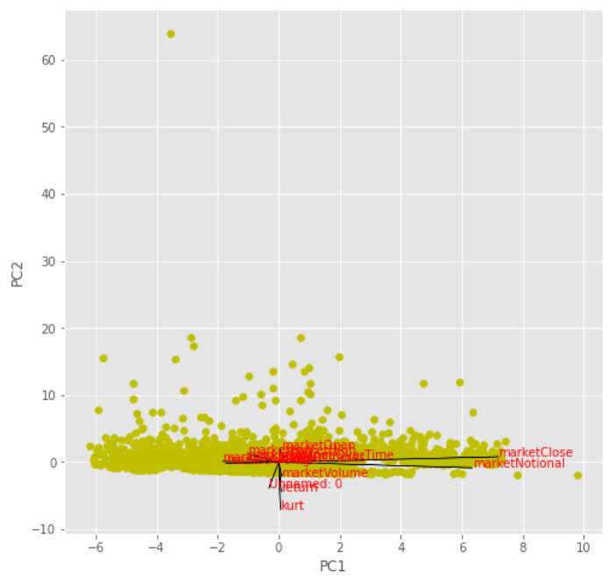
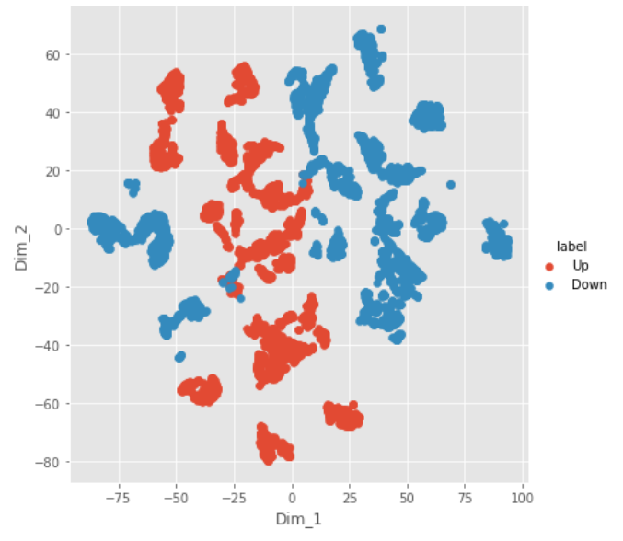
B.Partition transactions as up down in each interval and visualize your data by t-SNE, SPCA, and PCA
1. SPCA 2. TSNE

Slide 10
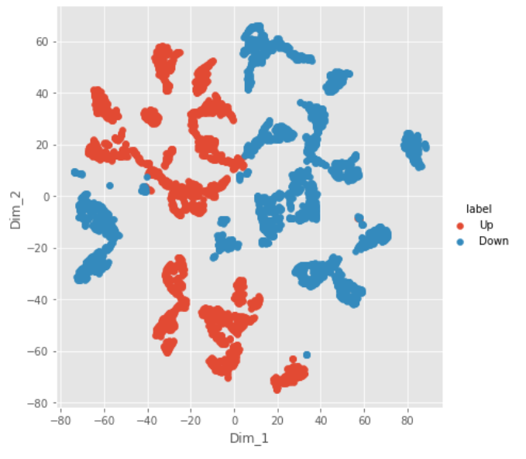
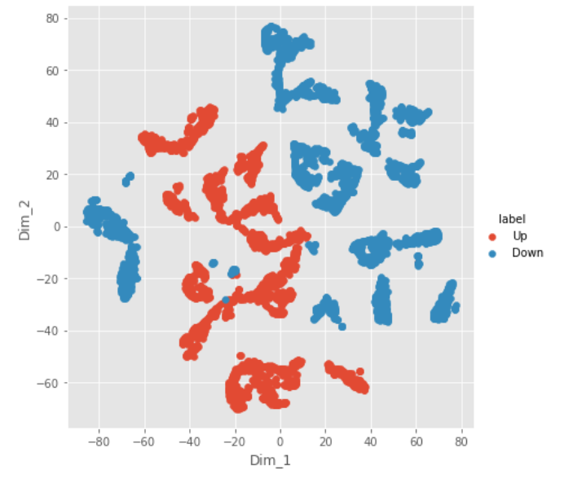
B.Different Distance Function
Cosine 2. Correlation The plot depends on the distance metric used. Cosine and correlation are very similar and create similar result
l = dt1.UpDown
xt = dt1.drop(['Date'], axis = 1)
xt = xt.drop(['UpDown'], axis = 1)
s_data = StandardScaler().fit_transform(xt)
model = TSNE(n_components = 2 , perplexity=40.0, random_state = 0 , metric='correlation')
tsne_data = model.fit_transform(s_data)
tsne_data = np.vstack((tsne_data.T, l)).T
tsne_df = pd.DataFrame(data = tsne_data,columns =("Dim_1", "Dim_2", "label"))
# Ploting the result of tsne
sn.FacetGrid(tsne_df, hue ="label", size = 6).map(plt.scatter, 'Dim_1', 'Dim_2').add_legend()
plt.show()

Slide 11
B. PCA Feature Importance

Slide 12
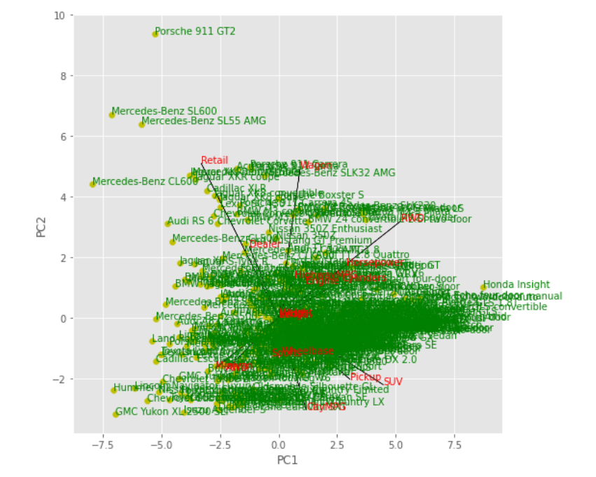
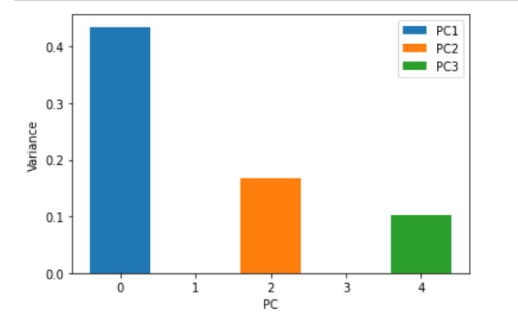
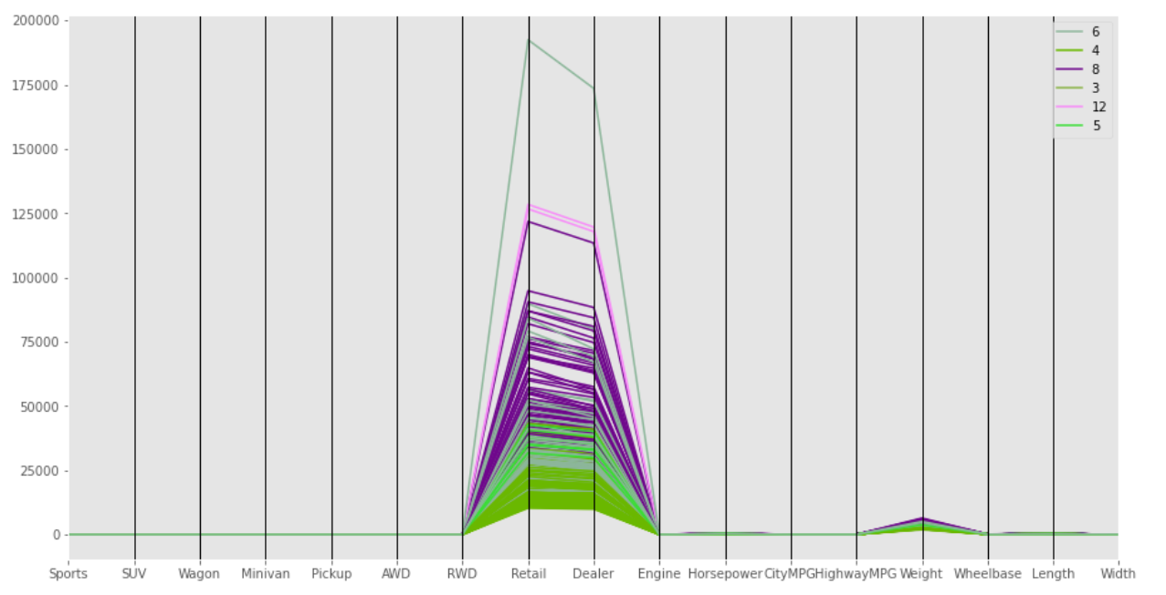
C. Vehicle PCA : VCR, BiPlot, Parallel Plot

Slide 13
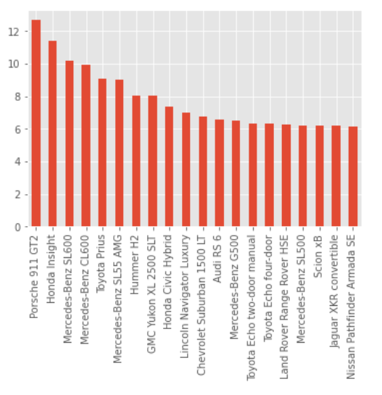
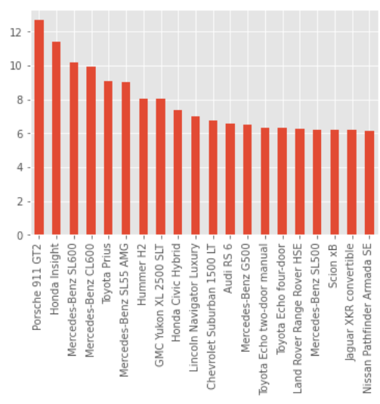
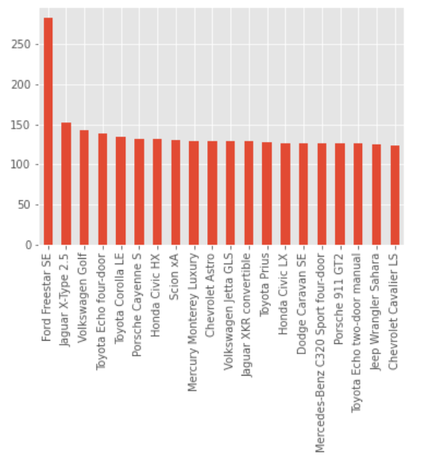
C. Ranking : PCA NSVA TSNE TSNE would be better at ranking the outliers, but the results depend a lot on the value of perpelexity. (40 in this case)

Slide 14
C. Vehicle Data : PCA plot 3D

Slide 15
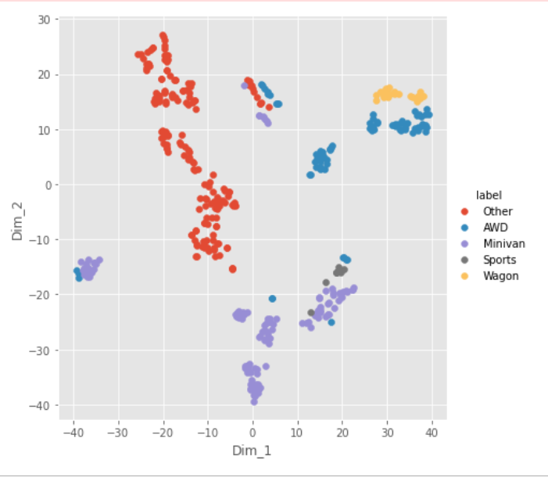
C. Vehicle Data TSNE
dt1 = VC_df
dt1["Type"] = np.where(dt1["Sports"]==1,"Sports","Other")
dt1["Type"] = np.where(dt1["SUV"]==1,"SUV",dt1["Type"])
dt1["Type"] = np.where(dt1["SUV"]==1,"Wagon",dt1["Type"])
dt1["Type"] = np.where(dt1["Minivan"]==1,"Minivan",dt1["Type"])
dt1["Type"] = np.where(dt1["Pickup"]==1,"Pickup",dt1["Type"])
dt1["Type"] = np.where(dt1["AWD"]==1,"AWD",dt1["Type"])
dt1["Type"] = np.where(dt1["RWD"]==1,"Minivan",dt1["Type"])
dt1.head(2)
data = dt1
l = data.Type
data = data.drop(['Type'], axis = 1)
s_data = StandardScaler().fit_transform(data)
model = TSNE(n_components = 2 , perplexity=20.0, random_state = 0)
tsne_data = model.fit_transform(s_data)
tsne_data = np.vstack((tsne_data.T, l)).T
tsne_df = pd.DataFrame(data = tsne_data,columns =("Dim_1", "Dim_2", "label"))
# Ploting the result of tsne
sn.FacetGrid(tsne_df, hue ="label", size = 6).map(plt.scatter, 'Dim_1', 'Dim_2').add_legend()
plt.show()

Slide 16
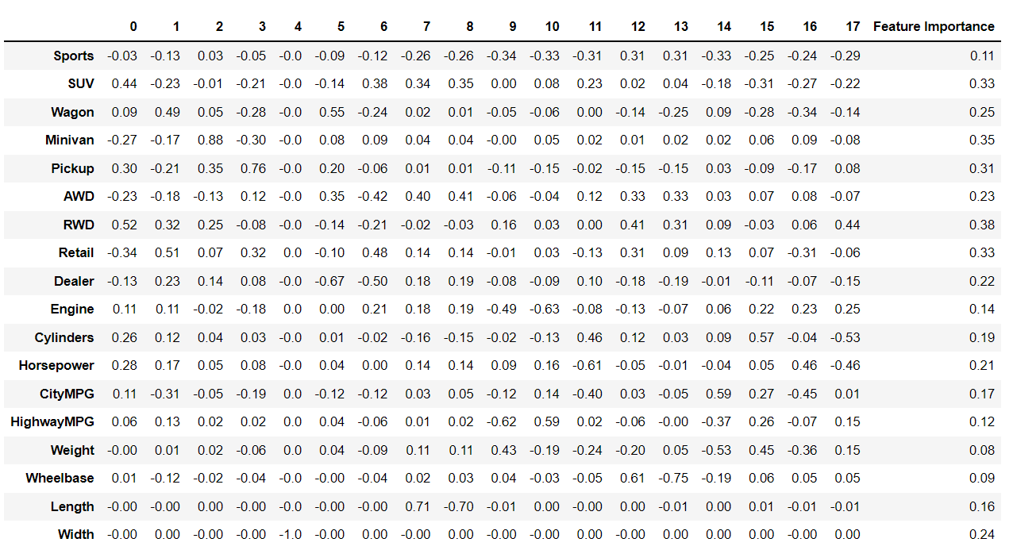
C. Vehicle PCA feature Importance

Slide 17
D) Locality preservation analysis
10-nearest neighbor (’10-nn-y’) in the embedding space of PCA and t-SNE? How many percents of them will repeat themselves? How about their order information?
Considering Order :
With Order :
PCA : 0
TSNE (perplexity = 10) : 3.24923
Without Order :
PCA : 6.56522717
TSNE (perplexity = 10) : 7.392
Relation between Euclidean Distance
Vehicle Data Avg Distance : 5.3848
Without Dim Red :
PCA : 5.3848
TSNE (perplexity = 10) : 78.18
With Dim Red :
PCA : 4.32
TSNE (perplexity = 10) : 22.44
So, PCA reconstruction is better. This shows that TSNE distance is larger than PCA distance.
HFT AAPL
Considering Order :
PCA : 0 %
TSNE (perplexity = 10) : 1.3%
Without Considering Order :
PCA : 6.0761
TSNE (perplexity = 10) : 7.1845
OTM data
Considering Order :
PCA : 0
TSNE (perplexity = 10) : 31.5
With Order :
PCA : 36
TSNE (perplexity = 10) : 73

Slide 18
Q4 . Code
from sklearn.preprocessing import StandardScaler
from sklearn.decomposition import PCA
def doPCA1(data):
norm = StandardScaler().fit_transform(data)
pca = PCA()
newdata = pca.fit_transform(norm)
return newdata,pca
npca1, pc1 = doPCA1(VC_df)
def doTSNE(data,k):
l = data.index
s_data = StandardScaler().fit_transform(data)
model = TSNE(n_components = 3 , perplexity=k, random_state = 0)
tsne_data = model.fit_transform(s_data)
return tsne_data
ntsne = doTSNE(VC_df,10)
data = StandardScaler().fit_transform ( VC_df.to_numpy() )
def get10NN(X):
nbrs = NearestNeighbors(n_neighbors=10, algorithm='ball_tree').fit(X)
distances, indices = nbrs.kneighbors(X)
return indices
ind = get10NN(data)
ind
def comp(x,y):
s = 0
for i in range(0,len(x)):
c = np.count_nonzero(x[i]==y[i])
s = s+c
return s
s = comp(ind,pcaind)
per = (s/(5850*10))*100
per
def comp(x):
s = 0
for i in range(0,len(x)):
for j in range(0,len(x)):
c = euclidean_distances(x[i].reshape(1, -1),x[j].reshape(1, -1))
s = s+c
return s/(len(x)*len(x))
s = comp(npca1)
s

Slide 19
Code :
def DD(data):
n,pca = doPCA(data)
PC = pca.components_
PC_df = pd.DataFrame(data=PC, index = data.columns)
plt.style.use('ggplot')
fig=plt.figure(figsize=(8,8))
for i in range(len(n)):
plt.scatter(n[i,0],n[i,1], c = 'y')
plt.text(n[i,0],n[i,1],data.index[i], c = 'g')
sc = 10
for k in range(PC_df.shape[1]):
plt.text( PC_df.iloc[k,0]*sc + .05 , PC_df.iloc[k,1]*sc + .05 , PC_df.index[k] , c= 'r')
plt.arrow( 0,0, PC_df.iloc[k,0]*sc + .05 , PC_df.iloc[k,1]*sc + .05 , color= 'k')
plt.xlabel("PC1")
plt.ylabel("PC2")
plt.show()
DD(VC_df)

Slide 20
def imp(data) :
#data = data.drop(['0'], axis = 1)
n,pca = doPCA(data)
PC = pca.components_
PC_df = pd.DataFrame(data=PC, index = data.columns)
PC_dim = PC_df
weight = pca.explained_variance_ratio_
#print(weight)
PC_dim["Feature Importance "] = (PC_dim**2).apply(lambda x : np.sqrt(x.dot(weight)), axis = 1 )
PC_dim = PC_dim.round(decimals=2)
return PC_dim
PC_dim = imp(VC_df)
PC_dim

Slide 21
##PCA
def do(data):
AAPL = data
AAPL = StandardScaler().fit_transform(AAPL)
n,pca = doPCA(data)
PC = pca.components_
PC_df = pd.DataFrame(data=PC, index = data.columns)
X = n
np.shape(X)
newData_df = pd.DataFrame(data = X, columns = ['PC' + str(i) for i in range(X.shape[1])], index = data.index)
newData_df.head(1)
df = pd.DataFrame(data = X,columns = data.columns)
newData_df['Ranking'] = newData_df.apply( lambda x : np.sqrt(x.dot(x)), axis =1)
ranking_20 = newData_df.Ranking.sort_values(ascending = False)[0:20]
#print(ranking_20)
ranking_20.plot.bar()
plt.show()
do(VC_df)

Slide 22
##TSNE
def do(data):
AAPL = data
AAPL = StandardScaler().fit_transform(AAPL)
n = doTSNE(data,30)
PC = n
PC_df = pd.DataFrame(data=PC)
X = n
np.shape(X)
newData_df = pd.DataFrame(data = X, columns = ['PC' + str(i) for i in range(X.shape[1])], index = data.index)
newData_df.head(1)
df = pd.DataFrame(data = X)
newData_df['Ranking'] = newData_df.apply( lambda x : np.sqrt(x.dot(x)), axis =1)
ranking_20 = newData_df.Ranking.sort_values(ascending = False)[0:20]
#print(ranking_20)
ranking_20.plot.bar()
plt.show()
do(VC_df)

Slide 23
def get10NN(X):
nbrs = NearestNeighbors(n_neighbors=10, algorithm='ball_tree').fit(X)
distances, indices = nbrs.kneighbors(X)
return indices
ind = get10NN(data)
ind

Slide 24
Reference
https://github.com/Shaif95
https://scikit-learn.org/stable/modules/classes.html
https://scikit-learn.org/stable/modules/generated/sklearn.manifold.TSNE.html

Slide 25

Thank You

